Slide 1
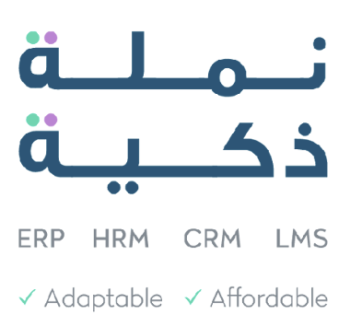


Maximizing ROI Through Digital Transformation
ERP HRM CRM
Numla – Company Profile and Solutions
Dublin . Brussels . Toronto
. San Francisco . Riyadh

Slide 2

About
We Deliver Fast, Cost-Effectively and High Quality Solutions
Numla was Established in 2000, headquartered in Ireland with offices in UK, USA, Canada, Saudi Arabia.
Focus: Specialises in customised ERP, HRM, CRM, mobile Apps, for medium to large enterprises. Offering ISO-certified, GDPR-compliant HRM and ERP for the complex holding companies.
Client Base: Diverse, international SMEs, including large enterprises and public companies. Innovation and Values: Known for disruptive solutions; flexibility, agility, responsiveness, client focus. Certifications: Multiple ISO certifications, for quality, security, and environmental management.
Why Numla? We ensure your success with affordable, customized digital solutions, trusted by global clients.
2

Slide 3

About
All your business on one platform – simple, efficient, yet affordable.
Founded: 2005, Belgium.
Users: Over 7 million; $319.1 million funding.
Apps: Open Source, 30+ core business applications, including CRM and accounting.
Market: From SMEs to large enterprises, with a focus on SMEs.
Global Presence Thousands of partners and employees worldwide.
USP: Open Source, Scalable, customizable, affordable.
3

Slide 4
With our smart, client-tailored solutions, we aim to address the multitude of challenges for our clients, stemming from outdated, unsupported, and inefficient IT or manual systems.
We understand your Operational Challenges that are
1. Manual Processes: Often our prospective clients manage various aspects of their operations manually, leading to time-consuming tasks and potential errors.
hindering Your Growth and Scalability.
Data Discrepancies: Using multiple spreadsheets for different functions can result in data discrepancies, duplication, and difficulties in maintaining accuracy.
Limited Automation: Despite some tools in place, achieving full automation across different business functions, including finance, customer management, and HR, remains an objective.

Slide 5
4. Lack of Customer/Supplier/Employee Self-Service: Absence of self- service options in various business tasks.
Operational Challenges:
5. Complex Compliance: Navigating regulatory rules, including GDPR
and other legislation, poses complexity in manual management.
6. Security Vulnerabilities: Handling sensitive business data and documents requires secure storage and communication, raising security concerns in the current manual system. Evolving cybersecurity threats and vulnerabilities require robust protection measures to safeguard business data.
Hindering Your Growth and Scalability
7. Data Integration Hurdles: Disconnected data sources and lack of efficient integration hinder real-time access to critical information.

Slide 6
Operational Challenges:
8. Outdated Legacy Systems: Dependence on legacy technology limits scalability, efficiency, and compatibility with modern tools.
9. Scalability Issues: Difficulty in scaling systems to accommodate
growth and evolving business needs can impede expansion.“
Hindering Your Growth and Scalability
10. Lack of Management Visibility: Absence of comprehensive dashboards and Business Intelligence tools limits management's visibility into key business metrics.
11. Growth Impediments: Difficulty in scaling systems to accommodate business growth and evolving needs can hinder expansion and competitiveness.

Slide 7
Smart Solutions that can be easily tailored to your requirements without additional costs
7

Slide 8
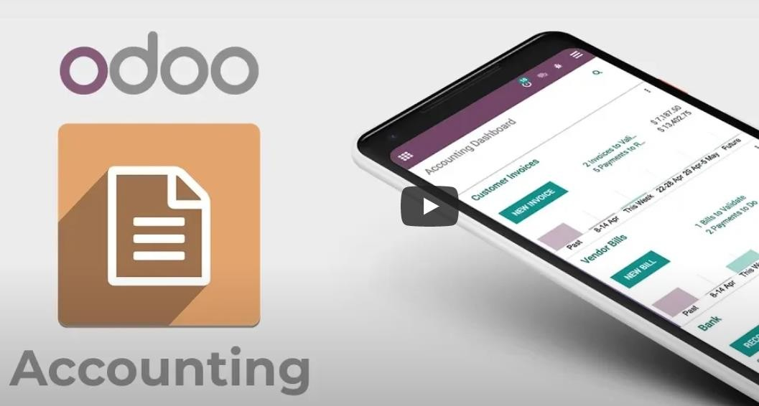
How we help?
1. Finance & Accounting: Manage money easily
Odoo offers full-featured accounting:
Available on multi-devices, Multi- company, multi-currency, multi-
operating units, Banks reconciliation
Irish Tax and VAT Reporting
Analytical accounting by area
Comprehensive financial reports
Accounts Payable, Accounts Receivable, General Ledger.
Cashflow management
Cash and Bank management
Fixed Assets Management
Reporting and Dashboarding

Slide 9
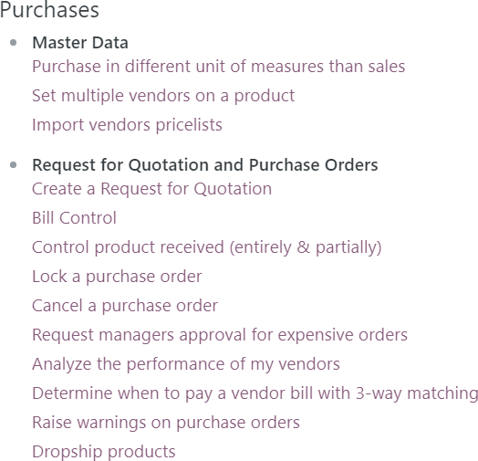

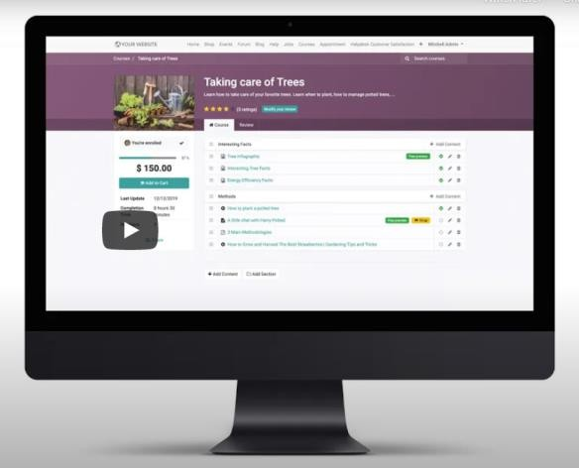
How we help?
2. Advanced Supply Chain: Never get out of stock

Slide 10

How we help?
3. Inventory Management and compliance
We offer you a comprehensive and refined way of managing inventory categories. You can manage the inventory the way you like. Some highlights are below:
Structure your inventory locations
Set auto reordering rules for purchase or resupply from another store location.
Manage expiry, lots, recalls, traceability, returns, damages, bar codes, and stock counts
Fully integrated with accounting (inventory valuation based on Average costs, and LIFO/FIFO batch costing.)

Slide 11
How we help?
4. Manufacturing, PLM & Quality Control
We offer integrated tools to streamline your product development and production workflows. Key features include:
a. Manufacturing Operations
Plan and manage work orders and production schedules
Track resource usage, machine availability, and labor efficiency
Configure multi-level bill of materials (BOMs) and routings
b. Product Lifecycle Management (PLM)
Manage engineering change orders (ECOs) and product revisions
Centralized documentation for design, specifications, and approvals
Cross-functional collaboration on product updates
c. Quality Assurance & Compliance
Define and enforce quality control points at any stage
Track non-conformances, corrective/preventive actions (CAPA)
Enable audit trails and regulatory compliance (ISO, FDA, etc.)

Slide 12
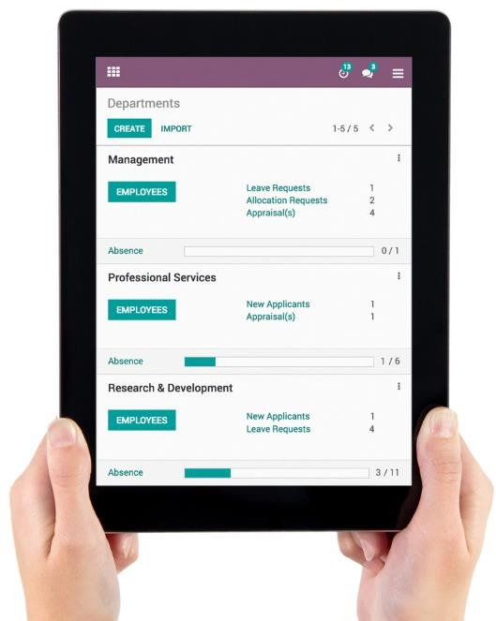
How we help?
5. Human Resources management and compliance
We will implement Human Resource Management System as per Irish Laws and Regulations.
Based on security set up you may restrict visibility of sensitive information to just HR managers, or make other information public for all employees to see such as employee directory. Receive alerts for any new leave requests, allocation requests, applications, appraisals, and more.
Recruitment (Job positions, specs, publishing, applicants tracking)
Flexible employee and contracts database
Multiple onboarding and off-boarding plans
Managing employee documents with expiry dates and advance alerts.
Integration with bio-metric attendance.
Timesheets for Locum nurses/doctors based on hours or activities performed
Leaves and Time-off management with coverage and delegation
Payroll and deductions management
Employee Evaluation and Appraisal and Surveys
Flexible approvals engine for diversified business processes

Slide 13
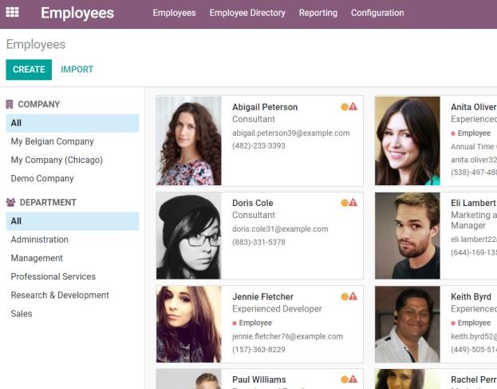
How we help?
6. Employees Self-Service via Dashboards
Our HR Apps allow employees to self-serve their Human Resource needs. The system would be customized and implemented as per MMC requirements. The key features include:
Employees can see the organization directory and hierarchy
Employees can view and verify their HR data, e.g. personal information, contracts, bank information, pay slips, payroll deductions, insurance, ROS, dependents, etc.
Employees can request data updates e.g. change of residence, Passport, etc.
Employees can upload themselves different documents e.g. CV, Certifications, licenses, legal permission, memberships, credentials, etc.
Employees can apply and track different type of leaves
Employees can view audit logs of all changes to their records
Employees can make many any approval requests online
Managers can review, approve/reject approval requests
Employees dashboards
Learning and Development
Expense Management
Internal Website management

Slide 14
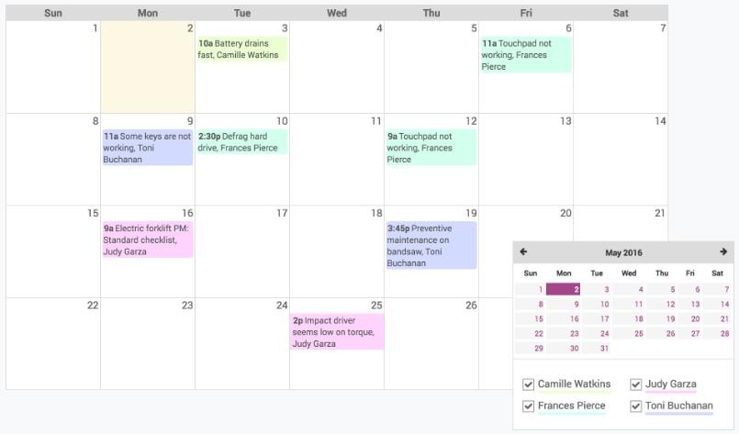
How we help?
7. Fixed Assets Maintenance and Management
We offer comprehensive facilities to the Assets Management Team to manage their processes.
A flexible database of all your assets properly classified with location, age, supplier,
manufacturer, maintenance history, maintenance contacts
Corrective maintenance using helpdesk
Preventive maintenance schedules based on time and/or usage
Management of Assets Installation/enhancements projects
Spare parts stock management
Spare parts procurement re-ordering
Team/Staff knowledge management
Team/Staff database management
Team/Staff schedule management
Dashboards and statistics

Slide 15
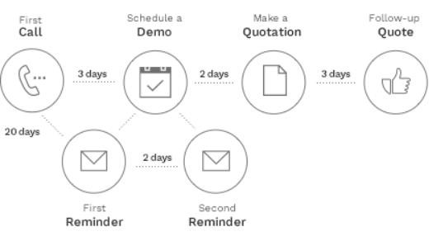
How we help?
8. Customers Relationship Management
Communication with customers and potential customers can be managed using CRM. You will get email marketing facilities, and you can share information with customers easily using email or SMS. Other capabilities include the following:
Leads management
Track the source of the leads to monitor your advertisement campaigns.
Live chat
Address book/multi-addresses
Customer preferences management
Full history attached to any patient e.g. calls, orders, invoices, total due, etc.
Schedule activities: calls, meetings, mailing, and quotations. Get all the information you need, directly on the opportunity: website pages viewed, mail received, etc.
Easily view audit logs/history of patient

Slide 16
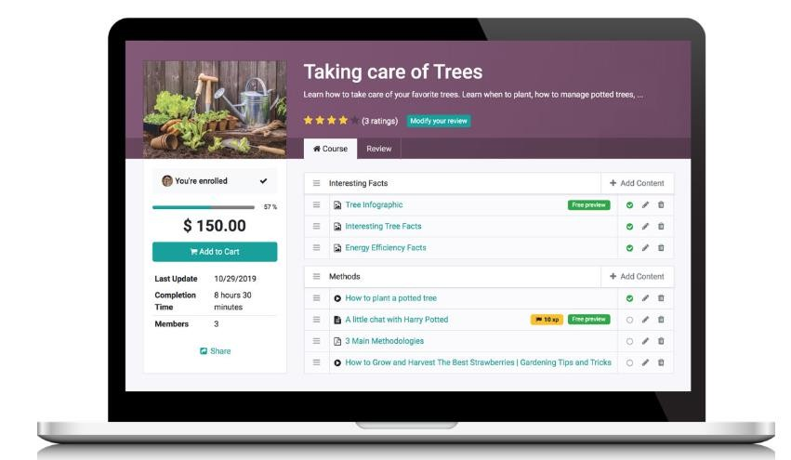
How we help?
9. eLearning and Training Management
Odoo eLearning is the perfect Learning Management System to enable Community learning, share knowledge, and manage certifications!
Engaging content: videos, presentations, documents, quizzes, and reviews
Self-paced learning: Participants can see their progress and whats next
Check how well people are learning and what they think of the content.
Certifications: Score advanced tests and see how many attempts lead to success.
Charts or tables - you'll find the perfect way to get insights into your courses and
certifications, the performance of your learners, and the revenues they generate.
Select the metrics that are relevant to you, apply predefined or custom filters, and pivot or group the results however you want them!

Slide 17

Numla has all that you need
HRM
Customized recruiting options to help you hire top talent
Self-service options that engage employees
Mobile time sheets that simplify attendance tracking
Extended payroll structures that eliminate
manual interventions
Simplified leave management that increases process efficiency
Self-Service Expense Management
Helpdesk and Ticketing
Accounting and bank integrations
ERP LMS
Employees record management,
onboarding, and off boarding
Streamlined evaluation process to guide decisions
Systematized appraisals to empower your
employees
Centralized HR updates and alerts for visibility
Integrated reports and dashboards to ensure high productivity
Comprehensive information and data security management
16

Slide 18

Case Study
Customer Testimonial by eir
17

Slide 19
As ERP, HRM and payroll data management service provider, Numla takes the safeguarding of client data and adherence to GDPR principles very seriously. Numla ensures that all personal data is collected and processed lawfully and transparently, implementing appropriate security measures to protect data against unauthorized access, accidental loss or destruction. Numla also regularly reviews and updates data processing policies and procedures, and conducts regular data protection impact assessments.
Data Protection as per
GDPR
In addition, Numla assures clients that their confidential data will never leave their servers located in Switzerland, providing an extra layer of security and privacy. These measures help to reassure clients that their data is being managed securely and in compliance with GDPR regulations, giving them peace of mind and confidence in Numla's services.
20

Slide 20
How we do it?
A Standard Implementation
Plan for ERP
22

Slide 21
Our implementation plan adopts an agile approach, placing paramount importance on user involvement, collaborative development, continuous testing, and delivering working software. This dynamic methodology ensures that the system's deployment is a collaborative and adaptive process, enhancing user satisfaction and system effectiveness throughout the implementation journey.
Implementation Plan
Phase 1: Pre-Implementation (2 weeks) Week 1-2: Project Kick-off and Planning Week 1:
Project Kick-off Meeting: Gather key stakeholders to introduce the project.
Define Project Scope: Confirm the exact requirements and expectations.
Establish Project Team: Appoint project manager, system administrator, and end-users.
Week 2:
Detailed Project Plan: Develop a comprehensive project plan, including timelines, tasks, and responsibilities.
Data Collection: Begin gathering existing HR data for migration.
Procurement: Ensure all necessary licenses and hardware are in place.

Slide 22
Implementation Plan
Phase 2: System Configuration (4 weeks)
Week 3-6: Configuration and Setup
Week 3:
System Installation: Set up the Numla.HR system on the designated infrastructure.
Data Migration: Transfer existing HR data to Numla.HR.
Week 4:
User Training: Begin training sessions for HR team members and end-users.
System Configuration: Configure Numla.HR according to your specific requirements.
Week 5-6:
Testing and Quality Assurance: Perform thorough system testing to identify and rectify any issues.
User Acceptance Testing: Conduct user acceptance testing with the HR team to ensure functionality aligns with expectations.

Slide 23
Implementation Plan
Phase 3: Implementation (2 weeks)
Week 7-8: System Rollout
Week 7
Final Data Migration: Perform the last data migration to ensure all records are up to date.
End-User Training: Continue user training sessions, focusing on self-service features.
Week 8
Pilot Deployment: Implement Numla.HR for a small group of HR team members to identify any
remaining issues.
Documentation: Develop user manuals and guides for ongoing reference.

Slide 24
Implementation Plan
Phase 4: Post-Implementation (4 weeks)
Week 9-12: Post Implementation Activities
Week 9
Full System Rollout: Deploy Numla.HR for all HR team members and end-users.
Transition Support: Provide immediate support and assistance as users adapt to the new system.
Week 10-12
Monitoring and Optimization: Continuously monitor system performance and user feedback,
making necessary adjustments.
Data Validation: Verify the accuracy of HR data in Numla.HR and address any discrepancies.
Final Training: Offer additional training sessions as needed to ensure all users are comfortable with the system.

Slide 25
Implementation Plan
Phase 5: Evaluation and Reviews (2 weeks)
Week 13-14: Evaluation and Fine-Tuning
Week 13
Evaluation: Conduct a comprehensive assessment of Numla.HR's performance against predefined goals and objectives.
Feedback Collection: Gather feedback from end-users and the HR team to identify areas for improvement.
Week 14
Fine-Tuning: Make necessary adjustments based on evaluation findings and user feedback.
Final Documentation: Update user manuals and guides to reflect any system enhancements.

Slide 26
Implementation Plan
Phase 6: Post-Implementation Support (Ongoing)
Week 15 and beyond:
Ongoing Support: Continue to provide support and assistance as needed.
Maintenance: Implement regular system updates, security patches, and maintenance to ensure
optimal performance.
User Training: Offer refresher training sessions and support for new employees as they join.
Conclusion
The above standard implementation plan outlines a structured approach to integrating Numla.HR at a typical client’s organisation. Regular communication and collaboration among stakeholders, along with diligent testing and training, will ensure a successful and smooth transition to the new HR management system. Adjustments to the timeline and milestones may be necessary based on the complexity of the implementation and feedback from end-users.

Slide 27
Company Profile
29

Slide 28
Our Mission
We empower medium to large enterprises with affordable and customized digital solutions for HR, ERP, and CRM, helping them achieve their goals and unlock their full potential for growth and profit.
Customer Focus - We prioritize our customers' satisfaction by understanding their unique needs and providing exceptional service.
Our Competitive Advantage comes from:
Agile Collaboration - We work together as a team to achieve your goals, sharing ideas and supporting each other.
Integrity - We conduct business with honesty, ethics, and moral principles, and we take responsibility for our actions.
30

Slide 29
Numerical Learning Algorithm (a branch of machine learning) is in short called ‘Numla’. At Numla, we offer affordable digital transformation services, along with unlimited customizations and integrations, all backed by exceptional customer service.
Our Story
Since 2000, Numla has provided enterprise-level solutions in HRM, ERP implementation, data analytics, and mobile apps to major companies like Baxter Healthcare, J&J, and eir. Originally established in Belgium and now based in Ireland since 2017.
Numla is Odoo international partner since 2017 in Europe, USA, and Canada. We are ISO27001, ISO9001 certified, and GDPR compliant. At Numla, we're a team of 45 passionate professionals with offices in Dublin, San Francisco, Toronto, Brussels, and Riyadh, dedicated to serving you personally, whether face-to-face or remotely, with exceptional service to help you achieve your digital transformation goals.
Certifications
31

Slide 30



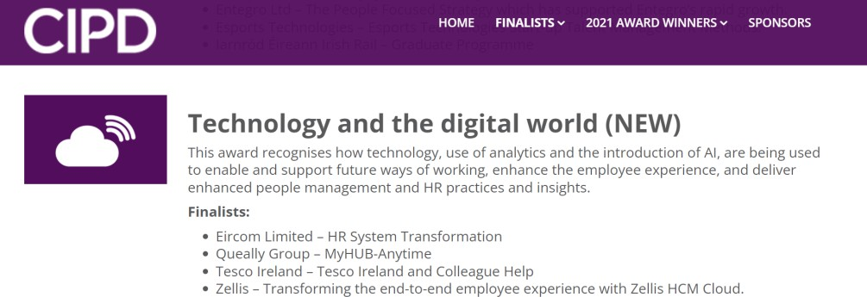
Our Recognition
We are certified with:
We were recognized by CIPD:

Slide 31
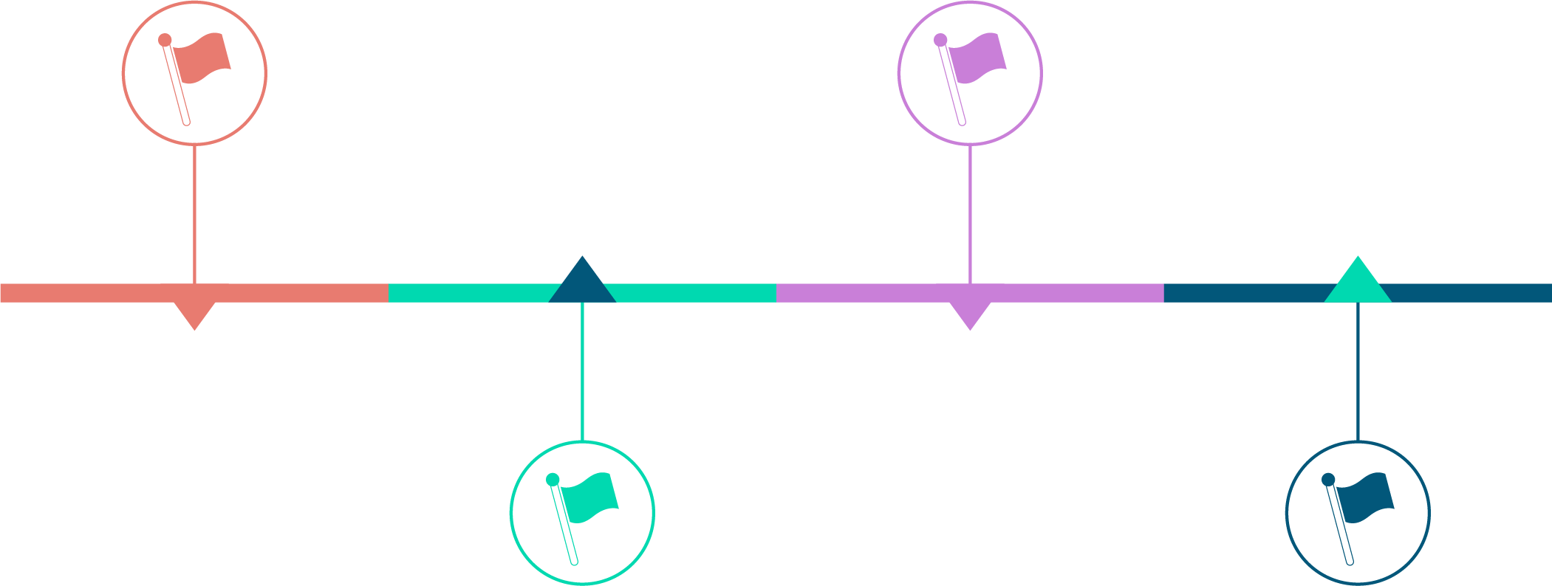
Our Story
2015
Focused on Implementing
ERP and business intelligence systems such as Oracle, JD Edwards,
MS Dynamics, and IBM Cognos for blue -chip organizations.
2023
An MNC Today
Empowering organizations across USA, Canada, Europe, the Middle East, and the Far East.
2000
Started Out
As a Belgian IT company.
2017
Launched Numla
Established our head office in Ireland.

Slide 32





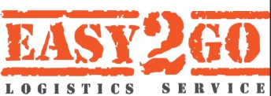


Our selected clients
. Customer Testimonial by eir - YouTube

Slide 33


Slide 34



Our large International clients
Irish Telecom (a 50 years old company) trusts us to provide daily HR services to 7000 employees.
We are managing their Odoo servers (7 of them) in AWS data center located in Dublin
We provide DevOps and Odoo Administration services
We manage their data based on GDPR standards.

Slide 35

Our large International clients
Namaste Technologies is a global ecommerce company listed on Toronto, Paris, Frankfurt stock exchanges.
We have provided a complete ecommerce solution
utilizing Odoo Enterprise v11 integrated with several ecommerce platforms including Amazon, eBay, Shopify, Magento.
Finance, Inventory, Retail modules were successfully implemented.

Slide 36
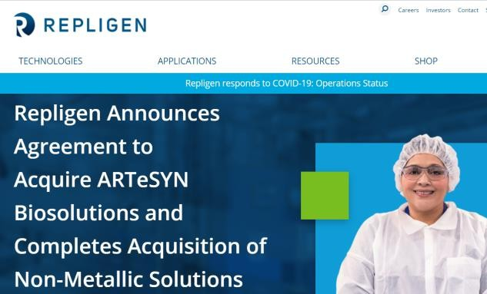
Our large International clients
Repligen and Artesyn, based in Co. Wexford, are using advanced manufacturing, inventory, and quality management
The solution was provided by us utilizing Odoo Enterprise
We are providing regular maintenance,
technical/functional support services to Artesyn based out of Ireland

Slide 37

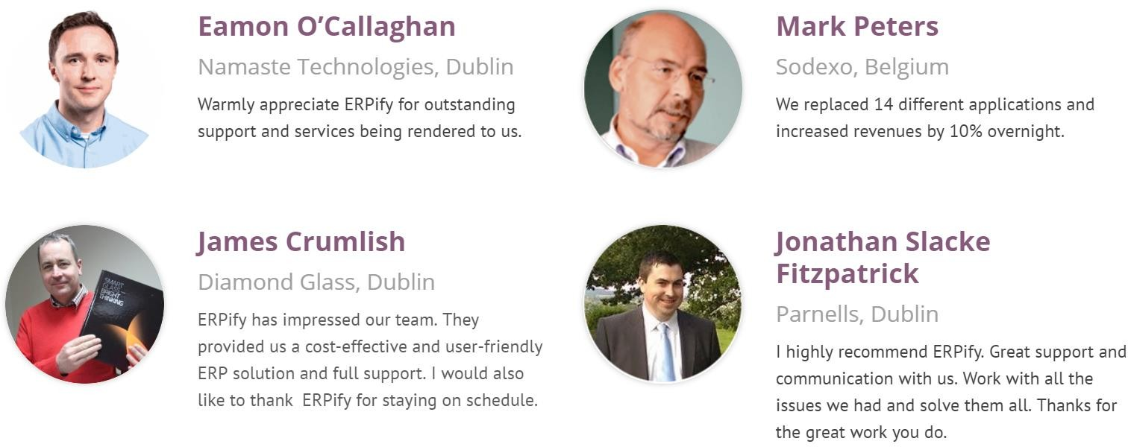


Client References
Joe Hall
HR Director, Irish Telecom, eir

Slide 38
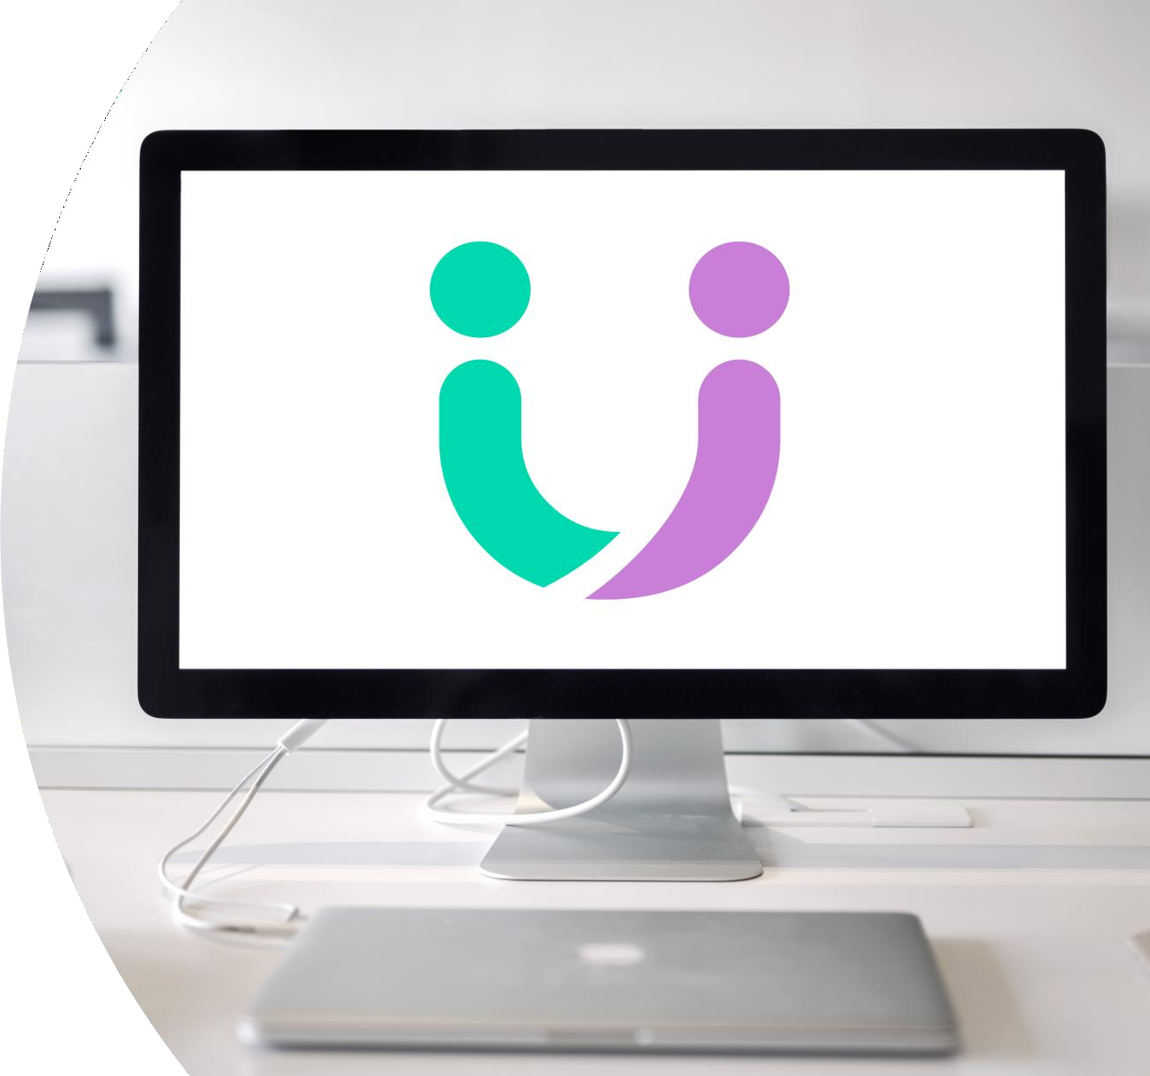

ERP Apps

Slide 39
Why select Odoo ERP
Odoo ERP is used and trusted by the large global companies around the world.
Odoo offers high value, quality, and low cost of ownership. You wouldn’t find a better option for sure!
With 7M users around the world, Odoo is recognized by Gartner as the most installed and fastest growing ERP.
Odoo is open source, easier to integrate,
and easier to use.
Odoo recently received funds of US$90M to further enhance its product and market position
Odoo is known as fastest growing business software in the world.

Slide 40



Why ERP projects fail vs. succeed?
1. Lack of Top Management Involvement
1. Management engages ERP as Business Process
2. Lack of Participation from Key Users
2. Key users engaged early and made
accountable.
3. Poor or Lack of Project Management
3. Issues/gaps defined with clear tangible targets
4. Heavy & Often Unnecessary Customization
4. Don’t aim for too much in the first phase.
5. Poor Consulting Quality
5. Choose the right partner /
the right methodology /
the right program management of
the right (ERP) product)
6. Wrong ERP Product

Slide 41
Where Return on investments comes from?
Benefits of ERP
You would greatly benefit from ERP implementation because of more streamlined processes, smoother operation, better employee service. In addition…
Your Level of Productivity would increase — In your current un- integrated system, you encounter data errors as departments are unable to accurately communicate, and real-time data is almost impossible to come by. You would save the cost of data errors and re-work in terms of time and money wasted.
You would get better Visibility — In your current system, you likely don’t have access to real-time data. The right data probably doesn’t move to the right people very efficiently, which means decision making takes longer and isn’t always accurate. Moving to ERP system will give you access to real-time data, which will give you greater financial control over your company.
Auditing and Compliance — How much are non-compliance fees currently costing you? In your current system, it’s likely you encounter non-compliance issues more often than you’d like — and many are probably easily removed once you move to ERP system that helps you audit your processes much more efficiently.
You’ll benefit from maintaining compliance requirements, and you
can calculate the savings.
Reduced Administrative Costs — Odoo ERP allows you to consolidate your financial reporting and several other administrative costs, which saves you money.
Improved Employee Service — Are you wasting money fixing unhappy employees? Are you losing good candidates due to an unorganized process or unreliable delivery on your promises? With the benefits of ERP system, you would retain more employees and attract better talent.
Industry experts estimate the typical time to see a return on investment on ERP is less than 12 months.

Slide 42
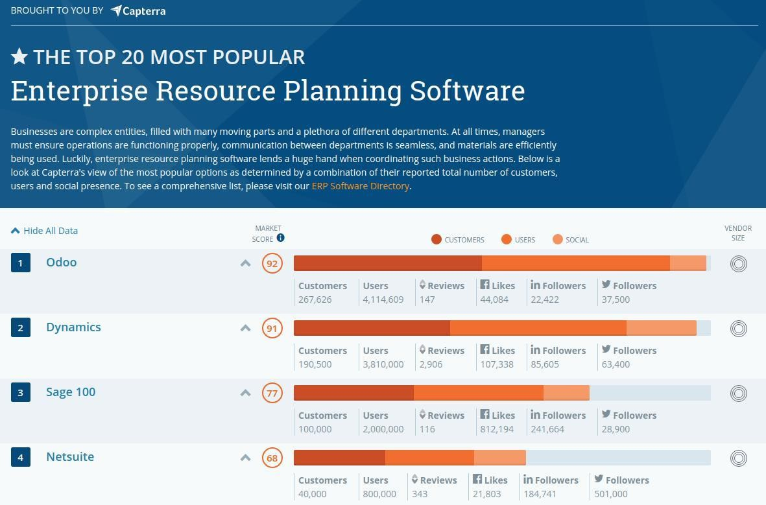

Slide 43
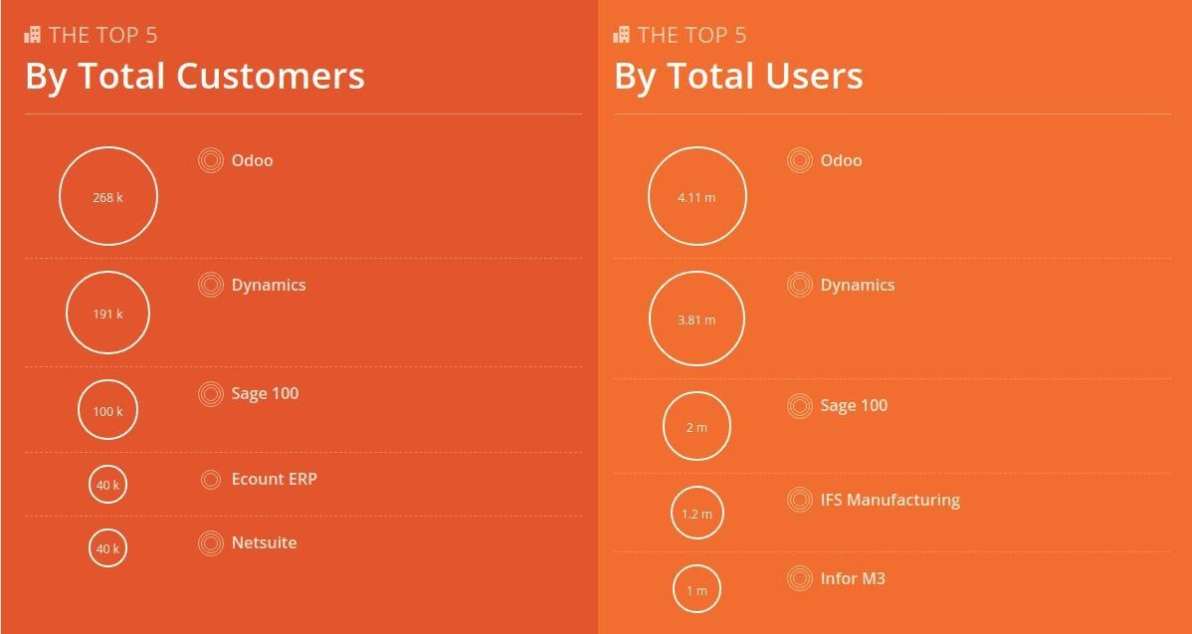

Slide 44

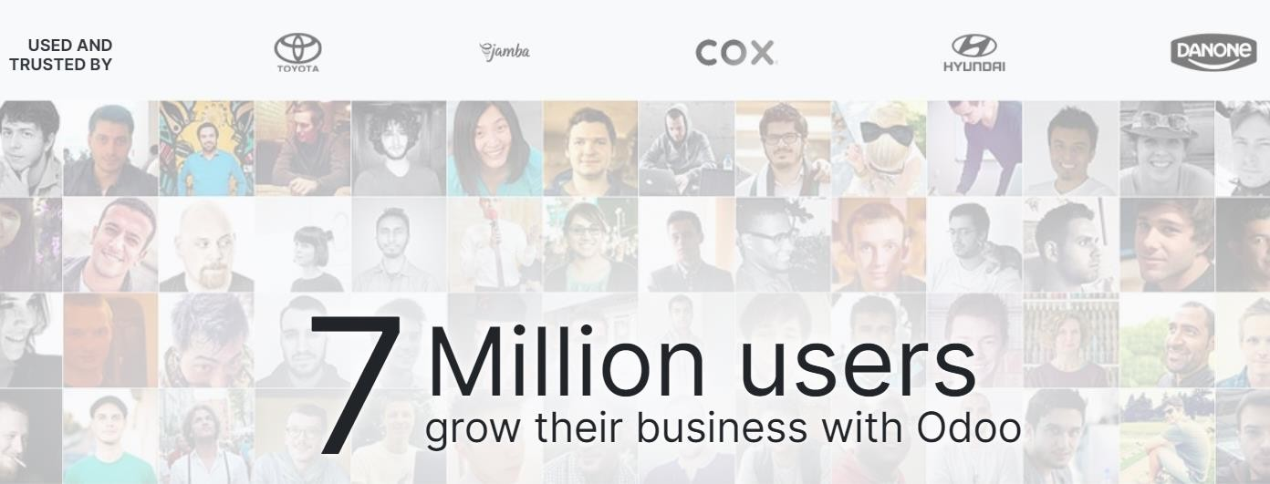
Case Studies

Slide 45



Slide 46
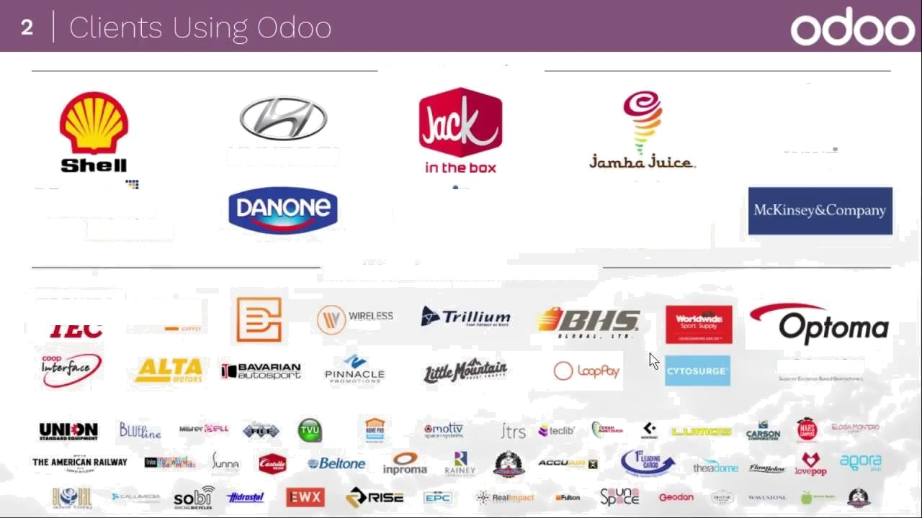



Large Enterprises
œ _
MFWF
¥entúa
wireless
foodpanda
SmaílYMadium Size Businesses
œ«æ+
LO6IC
NORAXON

